Slide 1
GLOBAL WARMING : CAUSES AND CONSEQUENCES
Presented by
Dr. ALPNA JYOTI
Assistant Professor / Guest Faculty
Deptt. of Geography, Marwari College, Darbhanga
LNM University, Darbhanga (Bihar)
Email Id – alpnajyoti1987@gmail.com

Slide 2
GLOBAL WARMING : CAUSES AND CONSEQUENCES
The act of warming the globe is simply called Global warming.
Warming the global along with its surrounding due to several factors is known as Global warming.
The increase of existing normal temperature of the global surface and surrounding atmosphere due to several causes is known as Global warming.

Slide 3
Responsible Major Gasses for global warming:
Chloro Floro Carban (CFC-12)
Carbon-di-oxide (CO2)
Methane ( CH4)
Nitrous oxide (N2O)
Ozone (O3)

Slide 4
Major Responsible Causes for
Global Warming

Slide 5
Causes for Global Warming
Deforestation
Black Carbon
Use of Chemical Fertilizers
Increase of Vehicles
Use of Supersonic Jets
Use of Pesticides

Slide 6
1. Deforestation & global warming
Cutting / burning trees or forest area in the different parts of the world encourages the increasing amount of carbon-di-oxide and other gases in the atmosphere which provokes global warming up to a large extent.
Burning trees/forests allows to store carbon contents in the atmosphere finally resulting in global warming.

Slide 7
2. Black Carbon & Global warming
A tiny particle of carbon released as a result of the incomplete combustion of fossil fuels, bio-fuels and biomass is known as Black Carbon.

Slide 8
3. Use of Chemical Fertilizers:
The use of chemical fertilizers is a significant source of greenhouse gas emissions and contributes greatly to Global Warming.

Slide 9
4. Increase of Vehicles
Our personal vehicles are a major cause of global warming. Collectively, cars and trucks account for nearly one-fifth of all US emissions, emitting around 24 pounds of carbon-di-oxide.

Slide 10
5. Use of Supersonic Jets
supersonic jets burn much more fuel per passenger than conventional jets.
“A new supersonic jets will consume as much as five to seven times as much fuel per passenger as subsonic aircraft on the same routes”.----The International Council on Clean Transportation.

Slide 11
6. Use of Pesticides
With a longer growing season and a warmer climate, weeds and insect pests will proliferate, most likely leading to more pesticide use – which is itself responsible for harmful emissions that further exacerbate climate.

Slide 12
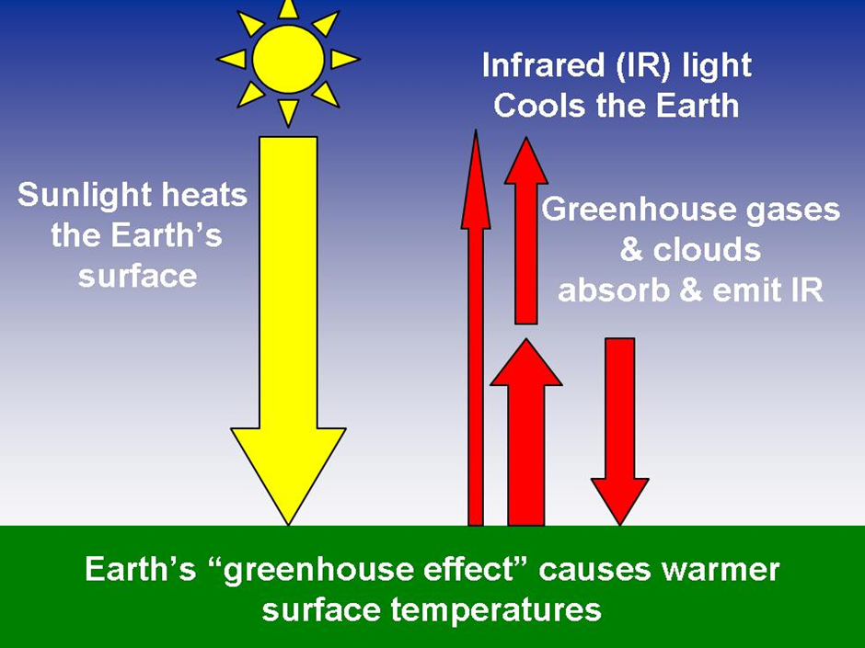

Slide 13
Effects
of
Global Warmining

Slide 14
Green House Effect
Glaciation : Melting ice of pole / mt. peaks or deglaciation
Increasing of sea level
End of fossils
Disappear of sea animals

Slide 15
6. Increases of Sea Floor
7. Increases of Sea Floor
8 The melting of the polar ice caps
9. Global Warming in the Future

Slide 16
THAKS A LOT
TO
ALL OF YOU

